Slide 1

MSc in Social Science Research Methods
DEVELOPING Core RESEARCH SKILLs
Semester 1 Week 10
Blogpost assignment
Dirk Lindebaum

Slide 2
Aims of this session
Review how reading two public blogposts about research can inform your learning about writing for non-academic audiences
Explore informal writing of blogposts
Introduce the blogpost assignment and explore key design considerations

Slide 3
Reminder: preparation Task 1 – student research blogposts
This task aims to inform your thinking about your blog assignment, as a blogpost reader
Go to the University of Chicago social science student research blog site:
https://socialsciences.uchicago.edu/research/student/blog
Browse the research students’ blogposts, designed to draw browsers’ attention to their masters or PhD dissertation research
Choose a blogpost that you think is well-written to attract and retain browsers’ interest
Print it out and bring three copies to share

Slide 4
Reminder: preparation Task 2 – read ‘Adam on-line’s blogpost
This task aims to inform your thinking about the blog assignment
Adam is a university research manager, and his blog is on applying for research grants – see http://socialscienceresearchfunding.co.uk/?p=749
Read the blog, and identify up to 3 aspects of Adam’s writing style that you think help to attract, inform and entertain browsers
Reflect on whether you should avoid any of the bad writing habits he identifies in trying to improve your own academic writing
Bring the blogpost, and ideas on writing style

Slide 5
1. Learning from your experience as a reader of public blogposts on research

Slide 6
Learning from reading public blogs (1)
Form groups of 3 or 4:
Share out copies of the research student’s blogpost you selected from the University of Chicago website
Read the unfamiliar blogposts
In turn, say how the author of your chosen blogpost attracted and retained your interest
Identify up to 3 ‘good blog practices’

Slide 7
Learning from reading public blogs (1)
What characteristics of you, as browsers of research student public blogs, should authors take into account – why?
Form groups of 3 or 4:
Share out copies of the research student’s blogpost you selected from the University of Chicago website
Read the unfamiliar blogposts
In turn, say how the author of your chosen blogpost attracted and retained your interest
Identify up to 3 ‘good blog practices’
Public blogs are designed to be read by browsers
But browsers don’t have to read them
So how can authors attract and retain the interest of their target audience?

Slide 8
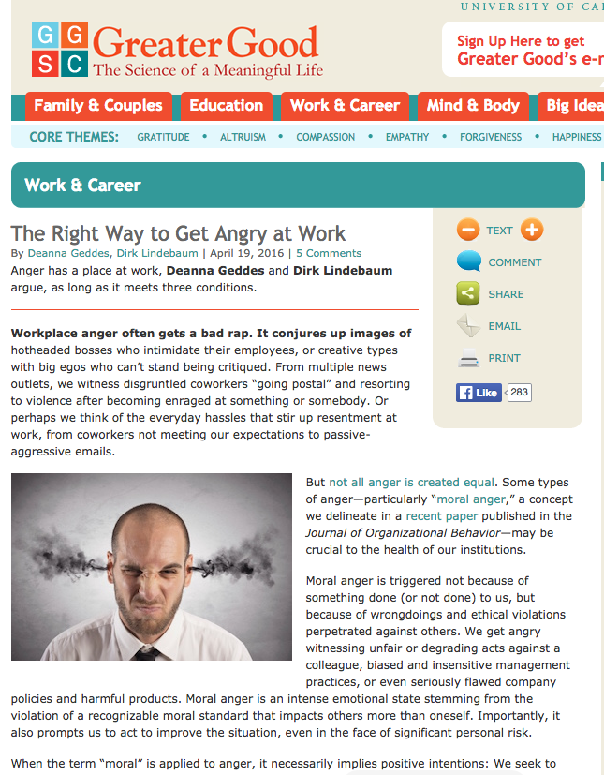
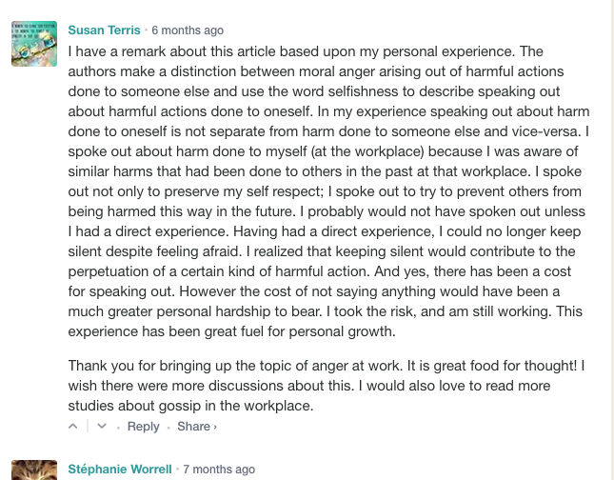
What makes a public blog public?
Public domain – not anonymous, unrestricted audience access (e.g. openly accessible, personal, university or university-sponsored)
May be non-interactive or interactive
Audience can copy and resend

Slide 9
What makes a public blog public?
Suppose you blog about your own or others’ research in the public domain…
Many social science research blogs are public, e.g.
University of Chicago research students blog – university-sponsored, non-interactive, staff check and publish posts submitted by students
‘Adam on-line’s blog – self-initiated, interactive blog about academics’ research proposals, the author states that he is a research manager at Nottingham University
What could possibly go wrong for you, the host, sponsor, others?

Slide 10
Learning from reading public blogs (2)
In your group:
Consider who you think is the target audience for Adam’s blog – why?
Share the aspects of Adam’s blogging style that you think help to attract, inform and entertain browsers
Review whether any bad writing habits he identifies in this blogpost have informed your thinking about improving your own academic writing

Slide 11
Learning from reading public blogs (2)
Imagine you are an academic at Nottingham University Business School
In your group:
Consider who you think is the target audience for Adam’s blog – why?
Share the aspects of Adam’s blogging style that you think help to attract, inform and entertain browsers
Review whether any bad writing habits he identifies in this blogpost have informed your thinking about improving your own academic writing
You’ve written research grant proposals and Adam has given you feedback on your drafts
You come across this blogpost
You realize that your writing habits may have informed the blogpost – how do you feel?

Slide 12
Learning from reading public blogs (2)
Imagine you are a senior academic at Nottingham University
In your group:
Consider who you think is the target audience for Adam’s blog – why?
Share the aspects of Adam’s blogging style that you think help to attract, inform and entertain browsers
Review whether any bad writing habits he identifies in this blogpost have informed your thinking about improving your own academic writing
You come across this blogpost
You perceive Adam to be implying that some academics here don’t know how to write
Do you see any implications for the university’s international reputation?

Slide 13

Public blogging Issues
Ethical – people you blog about may be identifiable to themselves or others, e.g.
Minimizing harms and risks – not harming others’ professional reputation
Respecting human dignity, privacy and autonomy – not embarrassing others, seeking informed consent

Slide 14
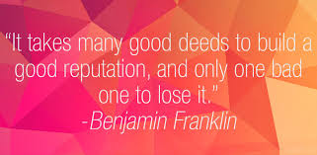
Public blogging Issues
Reputational – all involved or represented, e.g.
You – a grant sponsor or a potential employer could read your blog
People you write about who are identifiable to others
Your university – the host or sponsor wants to present a positive image of the university, your blogpost is evidence supporting our claim to provide high quality research training

Slide 15
Public blogging Issues
Legal – anyone involved or represented who perceives that a blog contains evidence of unethical or illegal behaviour, reputational damage…
My advice:
Aim to be an ethical research blogger
Check to avoid providing evidence of anything that could be interpreted as unethical, reputationally damaging, illegal
What range of potential legal problems can you imagine?

Slide 16
2. Informal writing of blogposts

Slide 17
Informal writing of blogposts: reminder – what it’s all for
Two-way critical academic and public discourse:
As a browser and reader, you choose what to read and evaluate others’ attempts to communicate and convince through developing their argument
So you must find a blogpost attractive, informative for understanding that argument, and entertaining enough to keep reading
As a writer, you develop your own argument that will communicate with and convince your target audience
So you must design a blogpost to be attractive, communicate well, and develop a convincing argument in entertaining way

Slide 18
Further tips on good public blogpost writing
Individually, start building up your own ‘good public research blogpost’ list
Make explicit your criteria about good practice based on your experiences as a browser (e.g. your chosen blogpost)
Enter each criterion into your personal ‘good public research blogpost’ list
Refer to your list to guide your blogging

Slide 19
Further tips on good public blogpost writing
Since blogging is informal, you can choose the style and structure of your blogpost
You could build on this beginning:
Type up this list on your computer
Habitually look out for more aspects of good or bad practice in the blogs you browse
Make explicit the criteria for good practice that you are implicitly applying
Add them to your list, apply them to your work
…and create the perfect blogpost assignment
But you can draw on your criteria of good practice, as readers, to inform your writing
You could take into account the following criteria…

Slide 20
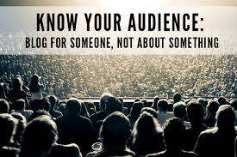
Some criteria to consider
Public blogposts about research should target an identified public audience with particular characteristics

Slide 21
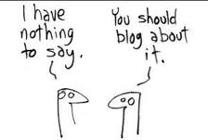
Some criteria to consider
Public blogposts about research should focus on how to attract, inform and entertain an audience with these characteristics, e.g.
Develop a clear argument whose conclusion is supported by some illustrative evidence
Optionally start with a ‘teaser’ (question, anecdote, puzzle…)
Optionally use pictures, quotes, diagrams, humour
Use an informal but low-fat writing style, signposting, quite short paragraphs
(As appropriate) give contact details, links

Slide 22
Some criteria to consider
The balance between attracting, informing and entertaining should fit the audience, e.g.
Research students, academics, journalists, professionals want to become informed
Most are not experts in your area, but support the social contribution of research
So you have to attract them first, then retain their interest so they become informed
Inform them through non-technical low-fat writing that conveys your argument clearly
A few optional diagrams or pictures may attract and entertain, but informing is priority

Slide 23

Some criteria to consider
You should think and write like a journalist
For a paragraph or section give the message first, then the backing
This represents a mini-argument: - conclusion – here’s what I’m claiming - warranting – here’s the evidence that should convince you
Go for [conclusion] because [warranting], not [warranting] therefore [conclusion]
[Warranting] therefore [conclusion] means readers won’t know what your warranting is for till they get to the punchline at the end

Slide 24
Making sure they get your message
Example of a journalistic approach:
[conclusion – the punchline]
My research on care home management is of great social significance,
[warranting] because there is an increasing need for well-run residential care in every country with an ageing population.
[more warranting] According to a recent report on 34 industrialized countries (OECD 2015), the proportion of over 65 year-olds has increased by 20% over the last ten years…

Slide 25
Risking them failing to get your message
Oh, so that’s why you’re telling me all this!
Example of a non-journalistic approach:
[warranting] According to a recent report on 34 industrialized countries (OECD 2015), the proportion of over 65 year-olds has increased by 20% over the last ten years…
[more warranting] As a result, there is an increasing need for well-run residential care in every country with an ageing population.
[conclusion – the punchline]
Therefore, my research on care home management is of great social significance.
Why should I care?
Maybe, but why tell me?

Slide 26
Blogpost criteria check-up
Which criteria did most or all of your blogposts meet?
In your group, review:
How far the research student blogposts you chose met these criteria, and why:
Targeted an audience that includes you
Tried to attract, inform and entertain
Gave priority to informing, but also attracted and entertained
Used a journalistic style – [conclusion] because [warranting]
Could you use these criteria to help you write your blog for assessment?
More on the assignment later…

Slide 27
3. Blogpost assignment preparation

Slide 28
Blogpost task (handout p1-2)
Create a blogpost designed to attract, enthuse and inform browsers about your area of research interest, aiming to convince them why this area is worthy of academic study (<750 words)
Use elements of web design to help make your blogpost interesting and informative

Slide 29
Blogpost task (handout p1-2)
You must describe and justify:
What your research area is, why it is interesting, and what kinds of questions, problems or issues are addressed in this area
Why addressing problematic aspects of the area may have academic, social or economic importance
Your current thinking on addressing a major question through your dissertation project
How browsers can contact you to learn more
[Marking requirement – false name, email address]

Slide 30
Blogpost task (handout p1-2)
The handout includes further guidance on how to create your blogpost
You must describe and justify:
What your research area is, why it is interesting, and what kinds of questions, problems or issues are addressed in this area
Why addressing problematic aspects of the area may have academic, social or economic importance
Your current thinking on addressing a major question through your dissertation project
How browsers can contact you to learn more
[Marking requirement – false name, email address]
Ensure you justify why your research is important and why you adopted your approach
But how you cover all the parts of your task is up to you! ☺

